Slide 1
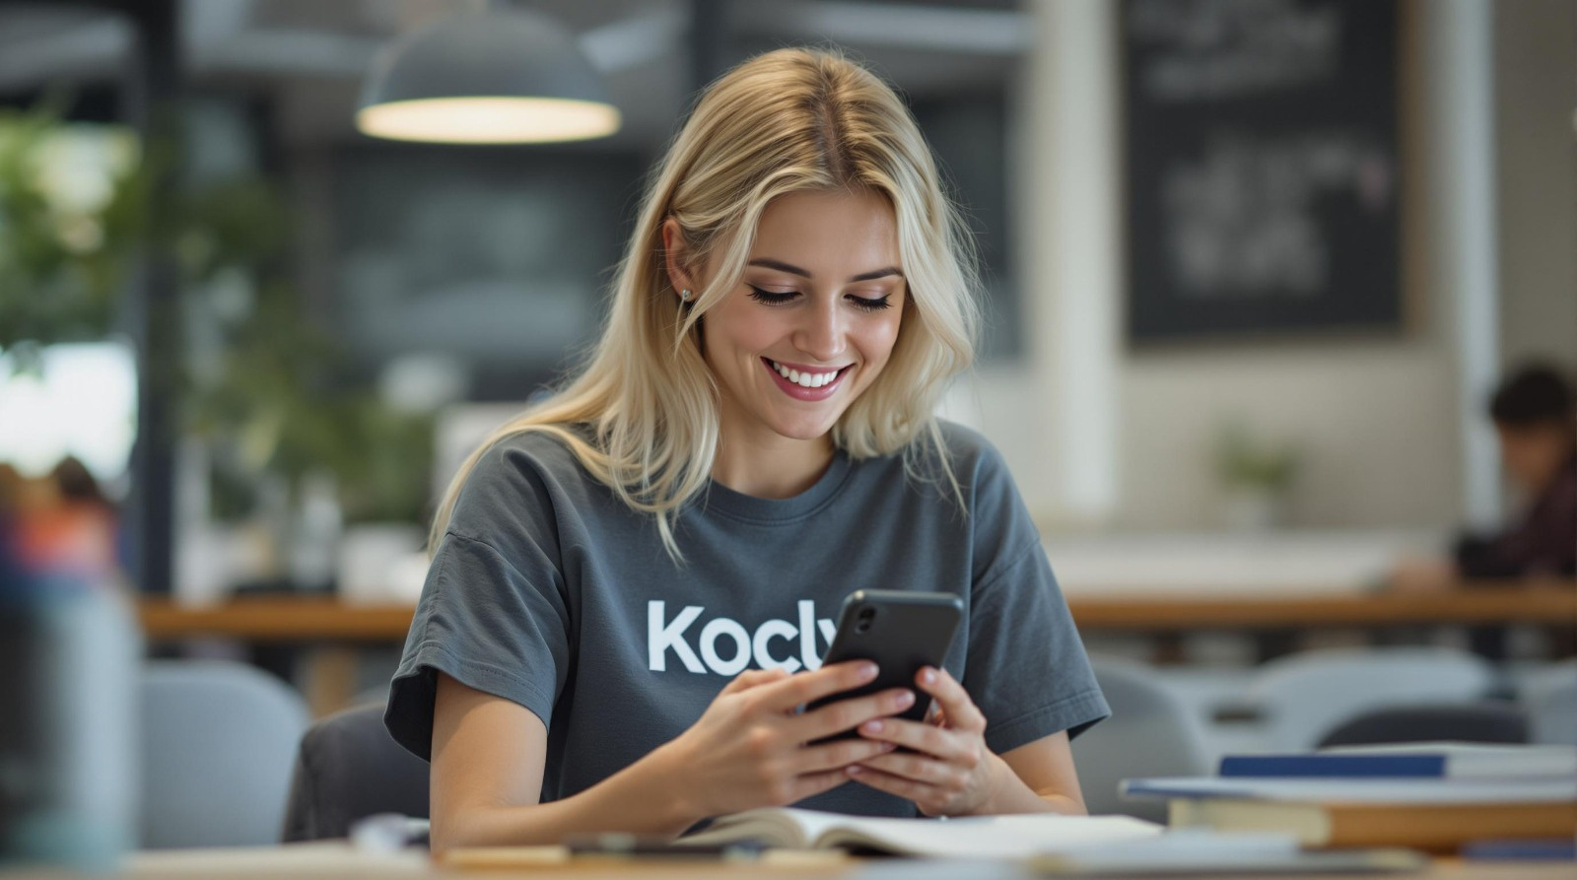


Investor Pitch-Deck
Kocly
Personal companion for efficient learning
.com
Kocly makes education
better and more accessible for everyone.
Kocly has been accepted into the Microsoft for Startups Founders Hub program and is eligible for up to $150,000 in credits.

Slide 2

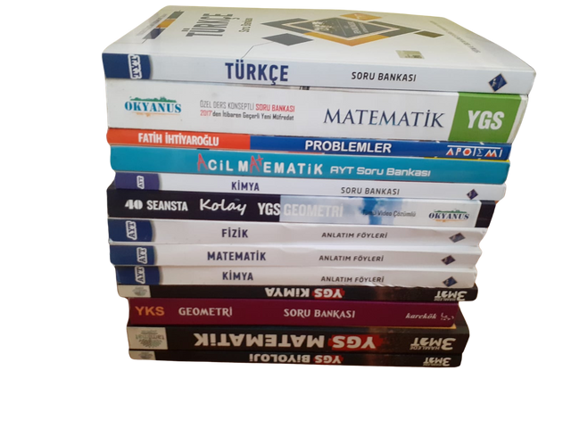
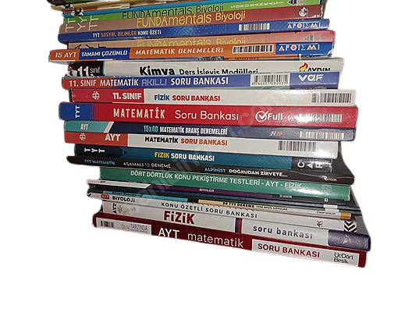
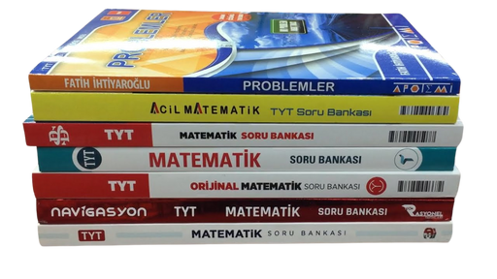
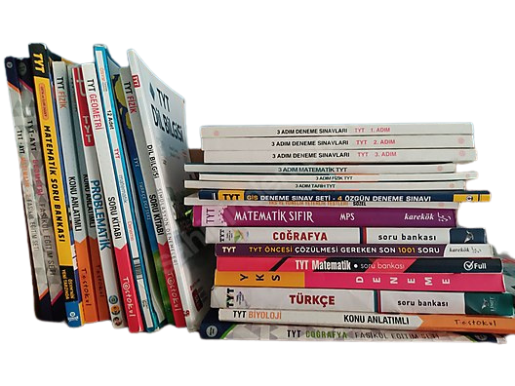


Kocly
Our Story
  University exam is life changing
  Preparation is painful
  Learning might be messy unless you know what to do
We suffered, we won,
we will help you win!
1

Slide 3

Problem
Kocly
Resources
Test books
Explanation books
Student
Success
Video solutions
YouTube Video Courses
Private courses
Schools
“Today’s students are not under-resourced, they are owerwhelmed.”
2

Slide 4




Problem
Kocly
Inequality in education
No guidance
No personalized feedback
Stress
Lack of motivation
Distractions
3

Slide 5

Solution
Kocly
Coaching Mechanism
Student
Personalized Learning
  Create personalized study plan
  Track and analyze the students’ performance
  Implement active recall & spaced repetition to prevent catastrophic forgetting
    flashcards and quizzes
Motivation Engine
  Use gamification elements for motivation
  Celebrate micro-achievements
  Share stats and progress
  Share motivational stories and examples
Resources
Books
Courses
Focus
  Prevent possible distractions in environment
Cost Effective
  Provide these services with an accessible cost for students
...
...
Success
...
...
4

Slide 6

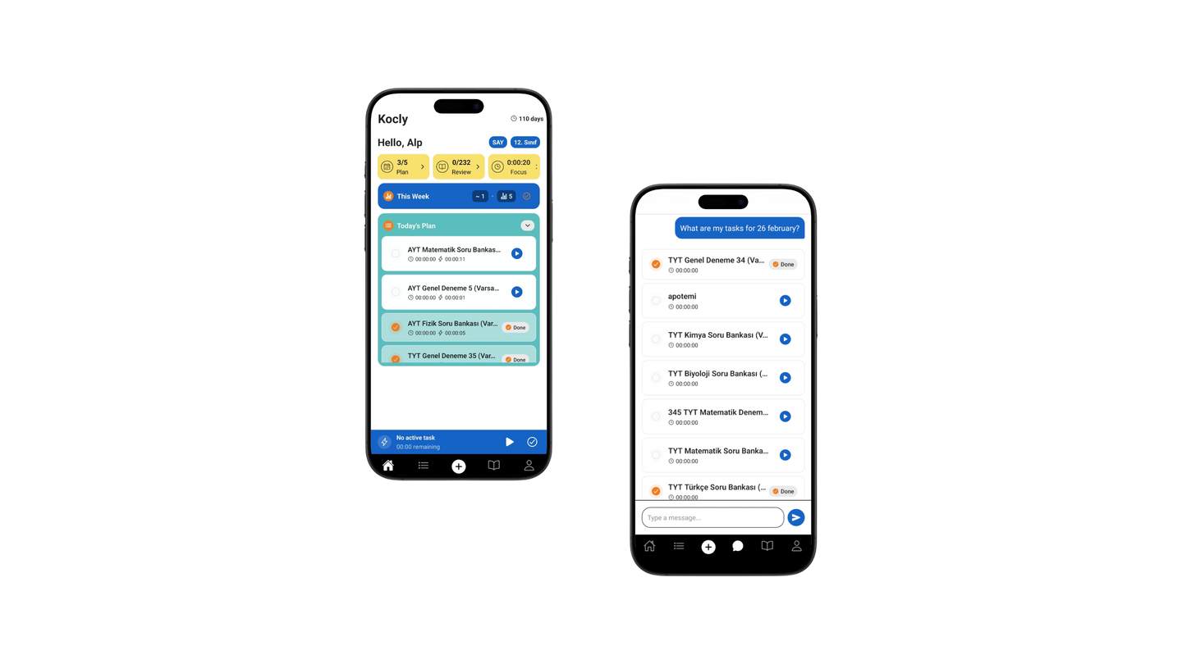
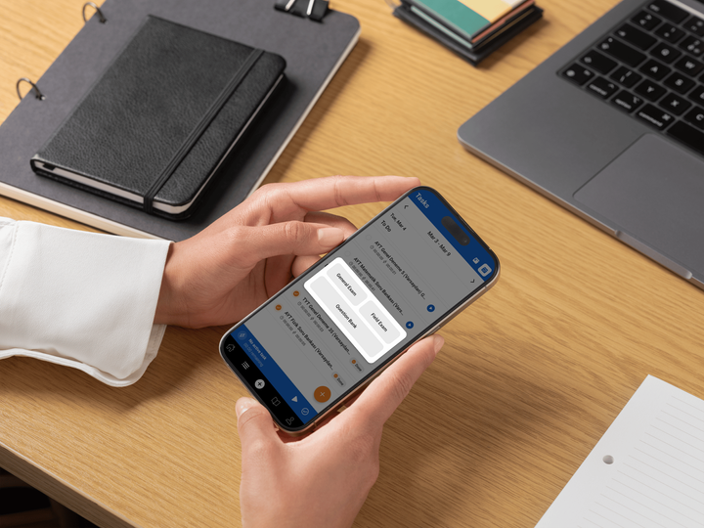

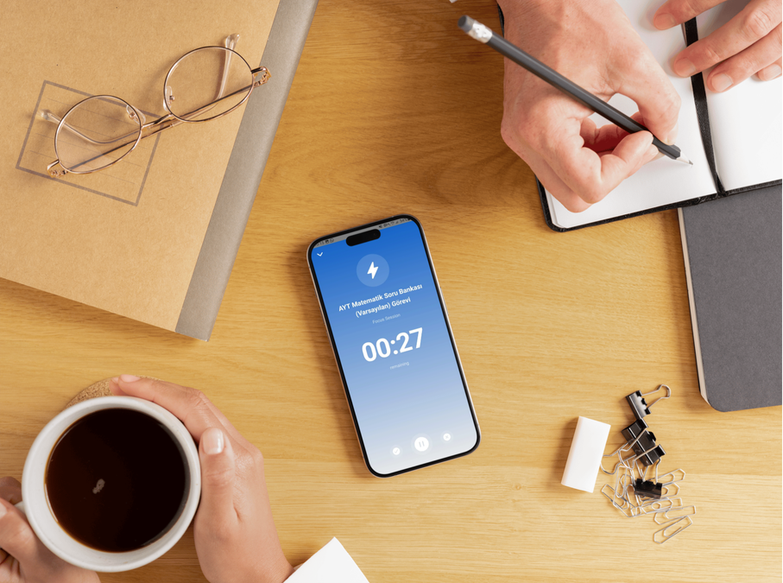
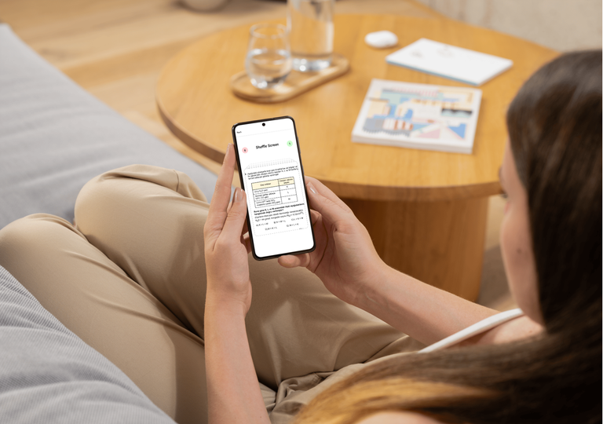

Kocly
Product
Start by learning in your school or course, it's your foundation.
Kocly acts as a “second brain” remembers progress, tracks insights for smart recall
Learn
Kocly AI Coach talks with the student, gather knowledge and use it to create structured study plans, adapts to progress, and keeps students accountable.
Review
Plan
Kocly AI Feedback analyzes performance, identifies weak points, and suggests gamified improvements
Kocly Focus Mode blocks distractions and gamifies study sessions with rewards and challenges.
Analyze
Focus
5
* The Kocly flower represents the five pillars of your learning journey.

Slide 7
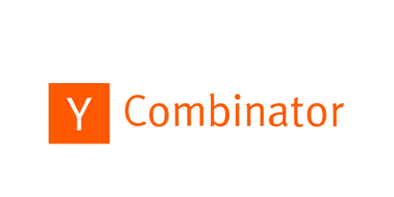
Why Now? | Market & Product Fit
Kocly
From Overwhelmed to Empowered
While traditional methods leave students struggling alone in a sea of content, Kocly steps in like a trusted guide, personal, smart, and always there.
  EdTech sector’s rapid growth → CAGR +15.5% (2025–2033)
  increasing number of LGS & YKS exam takers → CAGR +6%
  Declining university placement rates→ CAGR –4.2%
  Improving AI with 10x lower costs
  LLMs enable 24/7 scalable support
“For the first time,
AI can truly coach.
And, students asking for it.”
Requests for Startups 2025
Our Target Roadmap
Our survey revealed that
  82% of students struggle to track and fix their weaknesses
  87% want a personalized tool for structured repetition
2025
2026
2027
2028
LGS & YKS Launch
(8th & 12th Grade)
Other exam types
B2B Partnerships
(Schools & Publishers)
Global Expansion
(SAT, GMAT, etc.)
6
*For survey question please visit: https://docs.google.com/forms/d/1ew3vAGDwRI7Va6C-9Wn_lrTnu1tKEUbdi9d0oN3z4ws/edit

Slide 8










Competitor Analysis
Kocly
Online Coaching
1-1 Traditional Coaching
Digital Exam Prep Apps
Kocly
Personalization &
Memorization
High
Low-Moderate
Moderate
Low
Accessibility
Anytime
1 hour / week
2 hours / week
Anytime
Scalability
Yes
No
No
Partially
Cost
5$ / month
60$ / month
up to 200$ /month
up to 100$ / month
7

Slide 9
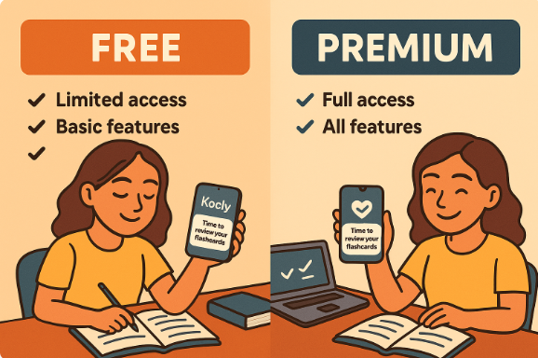
Business Model
Kocly
Freemium as strategy
Subscription Model
20,000 users free for two years, backed by Microsoft’s investment, with zero operational cost
Penetration Pricing
Affordable, margin-focused pricing for broad and agresive market entry and long-term growth
0$/month
5$/month
Benchmark driven pricing strategy has been applied to decide price
8
*Pricing is denominated in USD to ensure consistency and to support our planned market expansion.

Slide 10
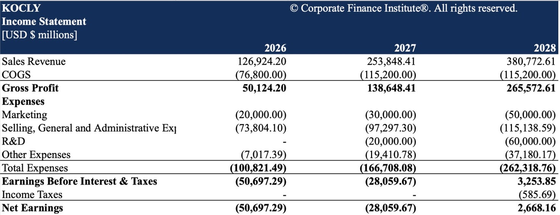
Growth & Revenue
Kocly
2026
2027
2028
Early validation with micro-cohorts
Run B2C acquisition experiments
Launch "Refer a friend" program
Other exam types
Q3 2025
Q4 2025
Global expansion
Localized campaigns
B2B partnership
Launch MVP via wishlist
Freemium for penetration
Click test via social media
Expected Income Statement
Financial Ratios
  Gross Margin= 54.6%
  Burn Multiple= 0.17
  EBIT Margin= –%16.7
Break-Even Point= 58.514 users
9
*Financial Ratios based on average values

Slide 11



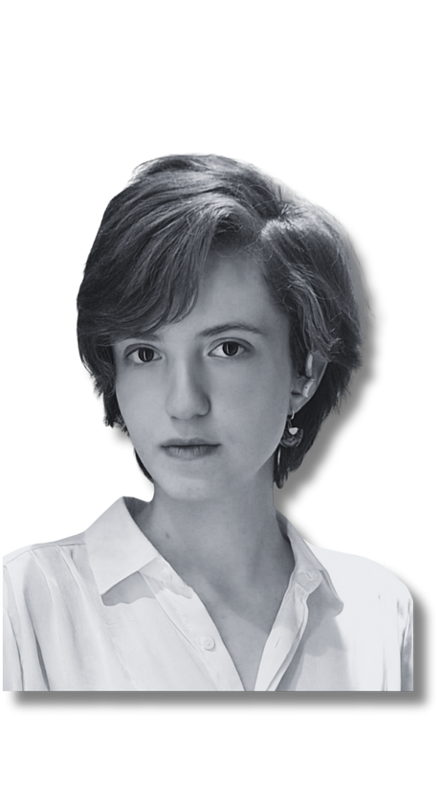
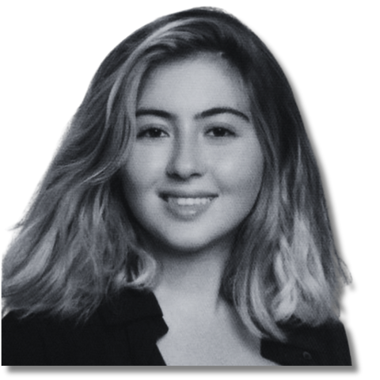



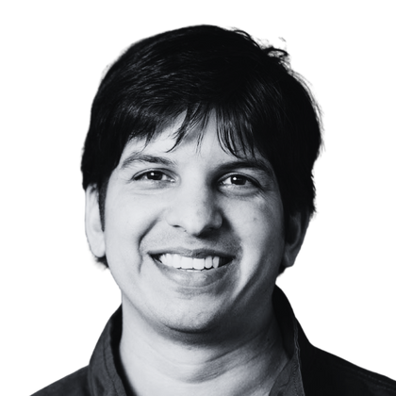



Team
Kocly
İPEK ÖZTEMİR
YAVUZ ALP S. ÖZTÜRK*
+
EBRAR SABİT
ALPSENCER ÖZDEMİR*
EMRE BEKTAŞ
Financial Affairs
Co-Founder & AI Specialist
Co-Founder & AI Specialist
Co-Founder
Marketing
Bilkent University
Business Administration
Bilkent University
Computer Engineering
Bilkent University
Computer Engineering
Bilkent University
Mechanical Engineering
Bilkent University
Business Administration
Consulted Experts
* Founders of
BILKENT
SOCIETY
Official Member of
MUTLU ÇUKUROVA
AYHAN SEBİN
AVISHKAR BHOOPCHAND
Campus Program
IBM Research
Professor of Learning and Artificial Intelligence
AI Ecosystem Development Executive
+ CS MSc. at
Staff Engineer
10
UCL
IBM Research
Google DeepMind

Slide 12
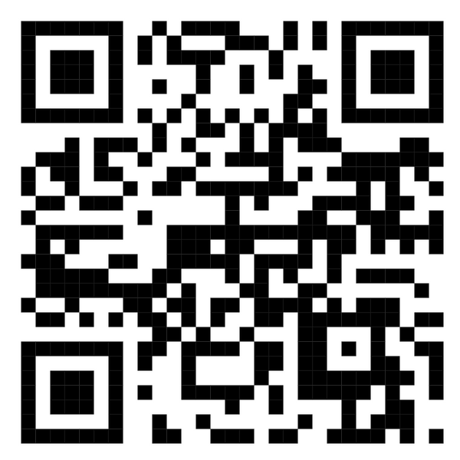


Contact
“Kocly is not just a study tool, it’s a true AI companion that works and helps students learn, plan, focus, and improve efficiently at an affordable cost.”
VISIT OUR WEBSITE
Kocly
info@kocly.com
www.kocly.com

