Slide 1
NFT
Marketplace for
Content
Creator

Slide 2
Problem
Low income for Content Creators
Creator-takes-all
Lack of Information and Authenticity

Slide 3
Low income for Content Creators
Early stage Content Creators have a hard time continuing their work due to low-to-no income.
Creator-takes-all
Early users and viewers of successful Content Creators have no benefits for excavating the gems.
Lack of Information and Authenticity
Hard for regular people to know information about the NFT market and the authenticity of the products.

Slide 4
NFT
Community that grows Together
With our NFT Marketplace we create a safe environment that benefits both Users and Content Creators.

Slide 5
Content for Sale
Contents Creators can sell their contents as NFTs as an additional income.
Growing Together
Users can buy contents as an investment and benefit as well.
NFTs You can Trust
Knowing the creators of the NFTs, you can better trust your purchases.

Slide 6
NFT
Market for
Content
Creators
An NFT market that has never existed before

Slide 7
Launch of NMCC!
2021 January
Quick Launch and Growth
10,000 users Reached
We were able to grow very quickly due to a low barrier for new users to approach.
2021 November
0.5% of Market Share Reached
2022 February

Slide 8
Timing
Emerging NFT market
First blockchain emerging form 2018 and NFT trending from early 2021
Mass increase of CC
Instagram and TikTok creating many new Content Creators
Notes:
From the first blockchain technology emerging from 2018 and NFT trending from 2021, it is still a very early technology that is barely a year old.
Platforms such as Instagram and TikTok made it possible for new Content Creators to come up on surface, creating new communities.

Slide 9
Traction
The market interest from the public is growing significantly
2021
2022
Graph 1. Interest over time from Gogle Trend of the word “NFT”
Notes:
The graph shows the traction of the word “NFT” from google.

Slide 10
Target Market
All young generations of platform users
Medium Sized
Content Creators
Those who have a great potential to grow/go viral.
Fans of Public Figures
People who are willing to use money for their idols.

Slide 11
Size of the Market
Massive size of the market means large pie to share
$8.47 Billion
0
$17.6 Billion
Market Size of Related NFT as end of 2021
Similar NFT Marketplace that exists
Market Size of NFT end of 2021

Slide 12
Content Creators
Sponsorships to Content Creators to create products to sell
Online Marketing
Marketing Strategy
Banners and video advertisements on related platforms
Main objective is for the platform to be “known” to the mass.
Oral Advertisements
After settlement, CCs will want to sell it’s products and advertise himself afterwards.
Partnership with Platform
Late goal is to establish direct pathway from larger platforms to NMCC

Slide 13
Direct
Competitors
Indirect
Competitors
Other NFT Marketplace that already exists in the market.
Other platforms that allows users/viewers to donate regularly.
Notes:
Twith and Youtube has functions that allow users to donate monthly to their favorite content creators.

Slide 14
Competitive Advantages

Slide 15
Advantage 1
Not only designers and artists, but also regular Content Creators can also join.
Advantage 2
The price of the contents allow general users to invest as well.
Advantage 3
Author of the NFTs are known which increases authenticity of the products.

Slide 16
At the early stage, 0.5% commission per trade for customers trading more than $1000.
1% commission per trade for regular users.
Business Model
Commission per trade
A small amount of “gas” fees low as $1~$5 will be included as a commission for each NFT uploaded.
Acquiring 5% of the market ($423.5 million) will bring profit of more than $2.12 million first year at the current commission rate.

Slide 17
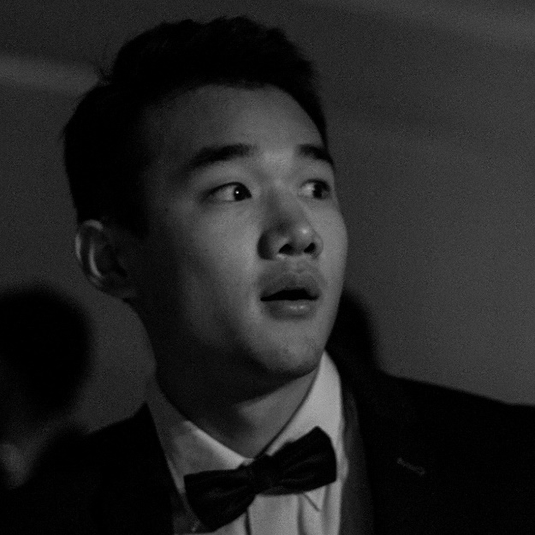
NMCC Team
Danny Kim
Mingyu Chi
David Chee
Co-Founder / CEO
Co-Founder / CTO
Co-Founder / CMO

Slide 18
Series A Investment
Q4 2022
Reach 50,000 Users
Future Roadmap
Q2 2023
What are your next steps and goals? How much support do you need from investors and what will it get you?
Acquire Platform Partners
Q4 2023
Aquire 10% of Market Share
Q4 2024

Slide 19
Employee’s Salary
Rent of Facility
Server Maintenance
Investment Requirement
500,000 Dollars
Content Creators’ Sponsorship
NMCC Marketing

Slide 20
Contact Us
+(90) 544 802 8867
+(82) 10 8855 1083
admin@NMCC.com
www.NMCC.com

Slide 21
Thank you
Feel Free to ask any questions you might have

